Slide 1
THE THREE-POINT VERTEX
HUGS 2015
June 01-19
Luis A. Fernández R.

Slide 2
Introduction
Gauge Theories
The fundamental interactions are dictated by the gauge principle
Gauge Invariance
Fundamental Interactions
QED, QCD and QWD describe the real world
They are renormalizable
Standard Model
Electroweak
+
QCD
Gauge group

Slide 3
Gauge Covariance
Consequences
QED:
Ward-Green-Takahashi Identity (WGTI)
Relation between Green functions
QED:
Ward-Slavnov-Taylor Identity (WSTI)
J.C. Ward Phys. Rev. 78 (1950) 182 Y. Takahashi Nouvo Cimento 6 (1957) 371 H.S. Green Proc. Phys. Soc. (London) A66 (1953) 873
J.C. Taylor Nucl. Phys. B33 (1971) 436 A.A. Slavnov Theor. Math. Phys. 10 (1972) 99

Slide 4
Gauge Covariance
Landau-Khalatnikov-Fradkin Transformations (LKFTs)*
Green functions in different gauges
L.D. Landau, I.M. Khalatnikov Zh. Eksp. Teor. Fiz. 29 (1956) 89 L.D. Landau, I.M. Khalatnikov Sov. Phys. JETP 2 (1956) 69 E.S. Fradkin Sov. Phys. JETP 2 (1956) 361
K. Johnson, B. Zumino Phys. Rev. Lett. 3 (1959) 251 B. Zumino J. Math. Phys. 1 (1960) 1
*As a consequence of the LKFTs we have the Multiplicative Renormalizability (MR) of the charged fermion propagator.

Slide 5
Schwinger-Dyson Equations (SDEs)
The SDEs are an infinite set of coupled integral equations that relate the n-point Green function to the (n+1)-point Green function.
Tipically, in the non-perturbative regime, SDEs are truncated at the level of the two-point Green function (propagators). We must then use an ansatz for the full three-point vertex.
F.J. Dyson Phys. Rev. 75 (1949) 1736 J.S. Schwinger Proc. Nat. Acad. Sc. 37 (1951) 452

Slide 6
SDEs
Fermion propagator SDE (Gap equation)
Fermion propagator
Photon propagator
Three-point (Fermion-photon) vertex

Slide 7
SDEs
Fermion propagator SDE (Gap equation)
Photon ropagator SDE

Slide 8
SDEs
Fermion propagator SDE (Gap equation)
Photon ropagator SDE

Slide 9
SDEs
Fermion propagator SDE (Gap equation)
Fermion-photon vertex
Ansatz
= ¿?

Slide 10
Three-point vertex
Criteria for any acceptable non-perturbative vertex
It must satisfy the WGTI.
It must be free of kinematic singularities.
It must have the same transformation properties as the bare vertex, under C, P and T transformations,
It must reduce to the bare vertex in the limit of the small coupling.
It must ensure the MR and the LKFT of the charged fermion propagator for any gauge variation.

Slide 11
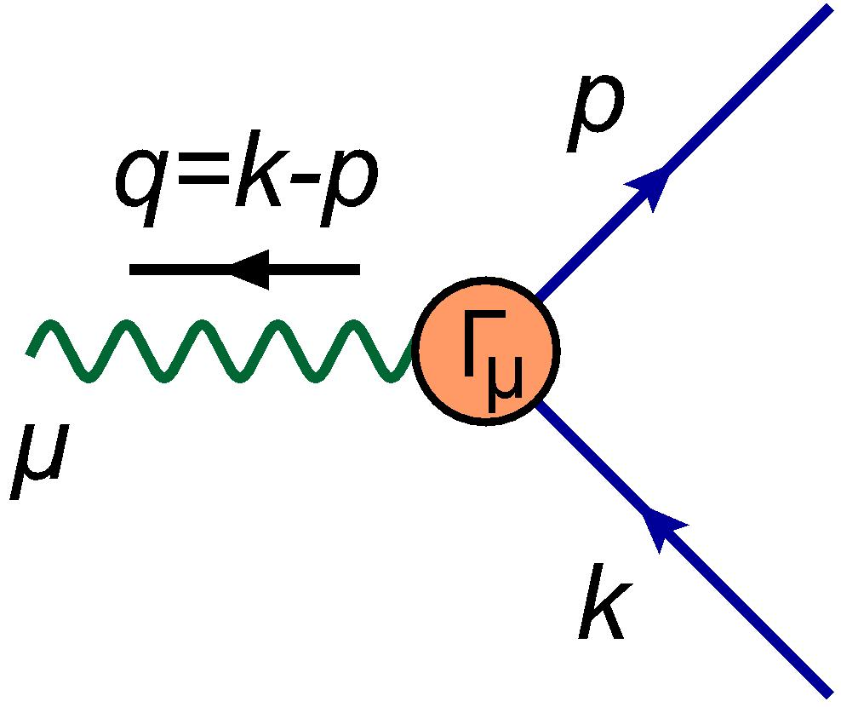
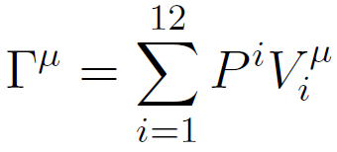
Decomposition of the vertex
Scalars:
12 tensor structures
Vectors:
General decomposition

Slide 12
Decomposition of the vertex
WGTI
Longitudinal and Transverse decomposition
J.S. Ball, T.W. Chiu Phys. Rev. D22 (1980) 2542

Slide 13
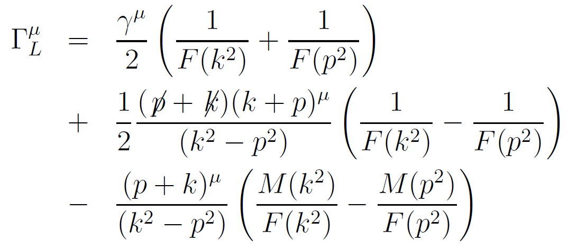
Longitudinal vertex
J.S. Ball, T.W. Chiu Phys. Rev. D22 (1980) 2542

Slide 14
Longitudinal vertex
J.S. Ball, T.W. Chiu Phys. Rev. D22 (1980) 2542

Slide 15
Transverse vertex

Slide 16
Works in QED
There exist a lot of literature addressing the problem of how to construct a fermion-boson vertex satisfying both the WGTI and the LKFTs, for example
D.C. Curtis, M.R. Pennington Phys. Rev. D44 (1991) 536-539 Z.H. Dong, H.J. Munczek, C.D. Roberts Phys. Lett. B333 (1994) 536-544 A. Bashir, M.R. Pennington Phys. Rev. D50 (1994) 7679-7689 A. Kizilersu, M.R. Pennington Phys. Rev. D79 (2009) 125020 A. Bashir, Y. Concha-Sanchez, R. Delbourgo Phys. Rev. D76 (2007) 065009

Slide 17
Ph. D. Research
In massless quenched scalar QED, I have constructed a non-perturbative three-point vertex satisfying the WGTI. This vertex involves a function W(x) whose integral restriction guarantees the MR of the scalar propagator. We propose an ansatz consistent with one-loop perturbation theory in arbitrary covariant gauge.
In QCD, I have to construct a non-perturbative quark-gluon vertex satisfying the WSTI and ensuring the MR of the quark propagator, in arbitrary covariant gauge.

Slide 18
Thanks!!

